Slide 1
The Battle of Neighborhoods
XIAOJUN GE

Slide 2
Introduction and background of NYC
Background
One of most densely populated and competitive city
Italian families immigrated into USA in late 19th and 20th century
Target
Explore boroughs, neighborhoods of NYC
Explore Italian restaurants in NYC

Slide 3
Data acquisition
Basic background & information of NYC
https://en.wikipedia.org/wiki/New_York_City
Neighborhoods and Borough dataset
https://geo.nyu.edu/catalog/nyu_2451_34572
Dataset in json format
https://cocl.us/new_york_dataset
Foursquare API
https://developer.foursquare.com/

Slide 4
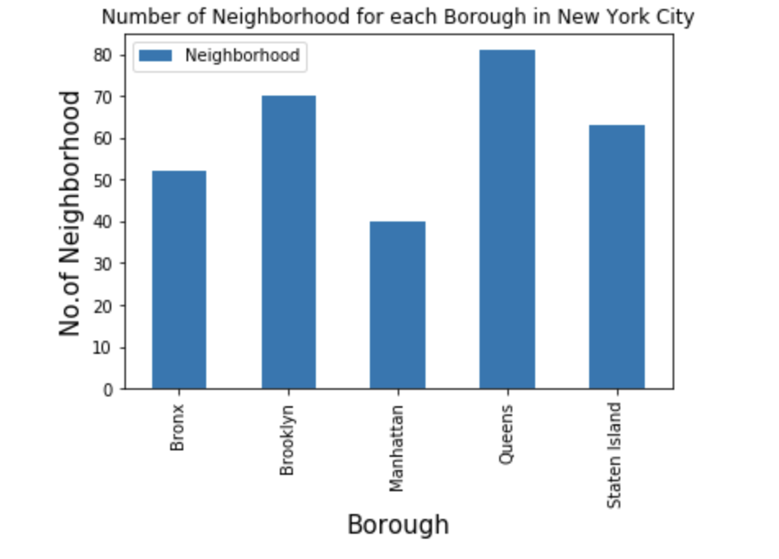
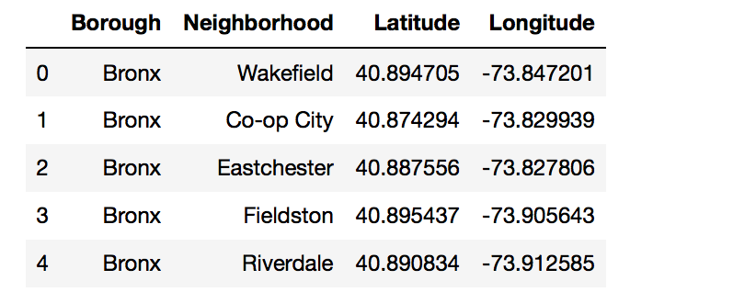
Exploratory data analysis - NYC
Neighborhood information in NYC

Slide 5
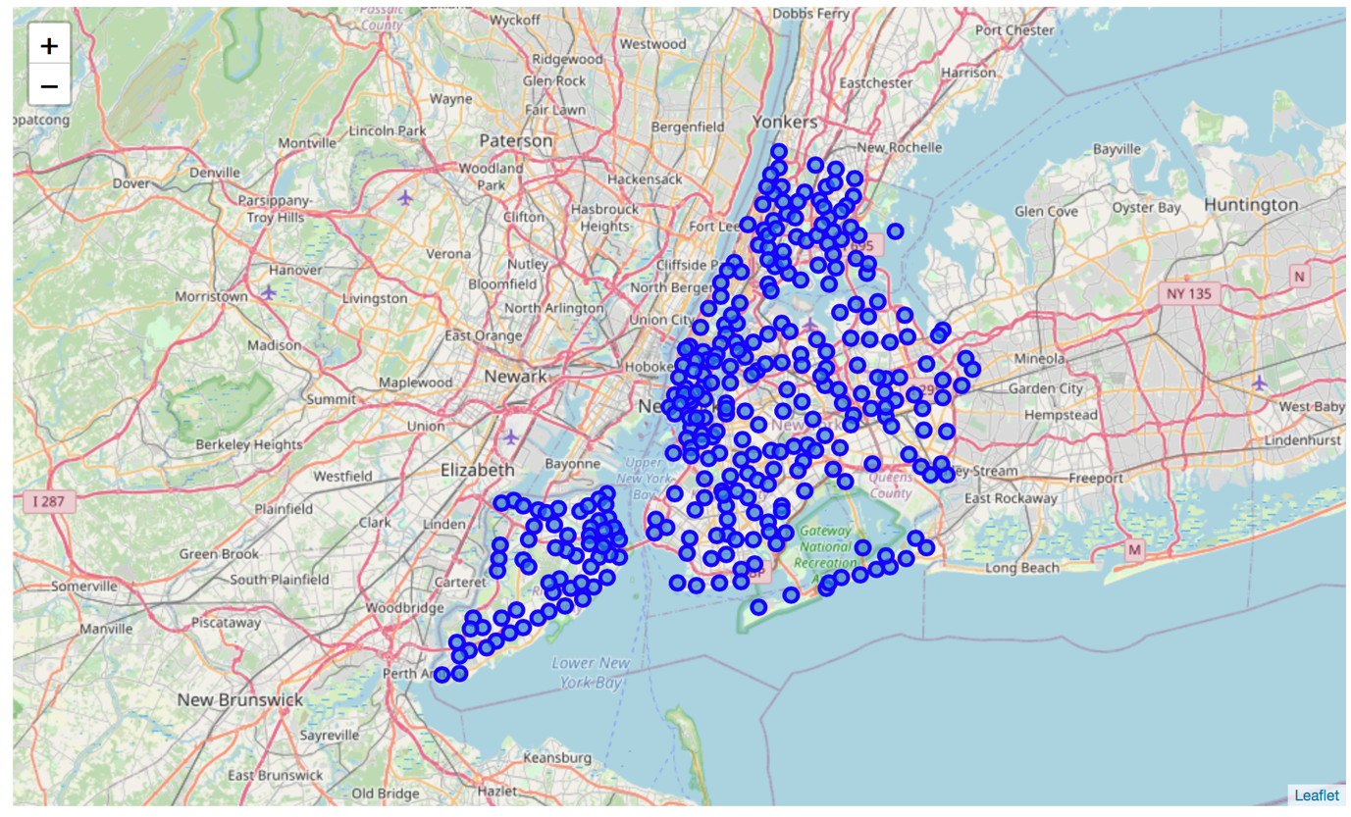
Exploratory data analysis - NYC
Geo-location of NYC

Slide 6
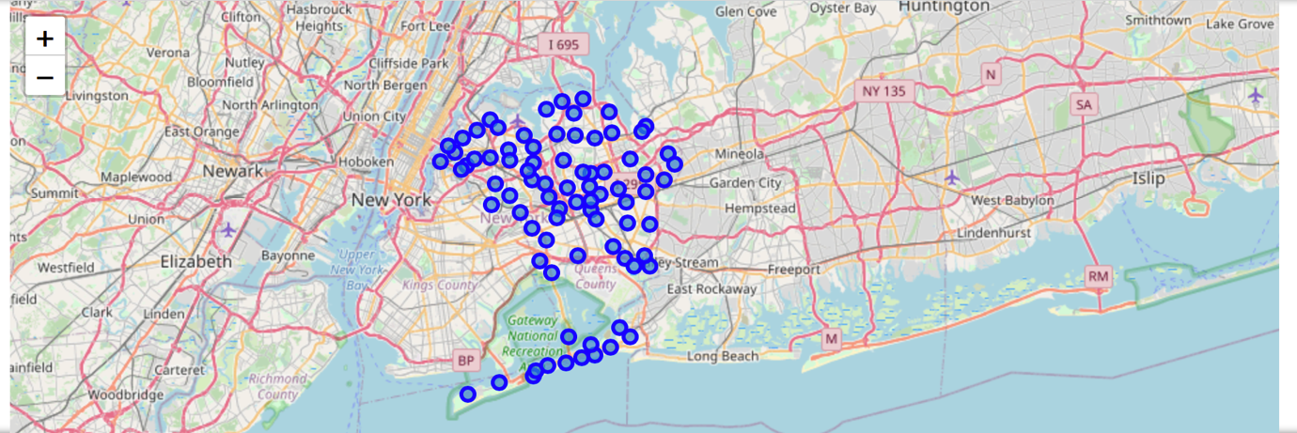
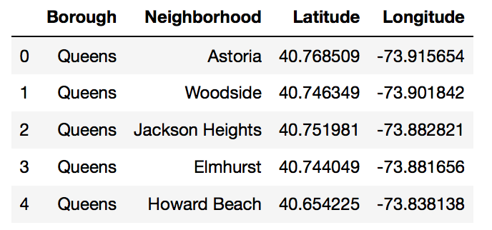
Exploratory data analysis – Queens(NYC)
Neighborhoods and geo-location of Queens

Slide 7
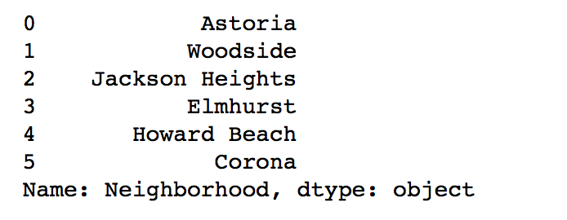
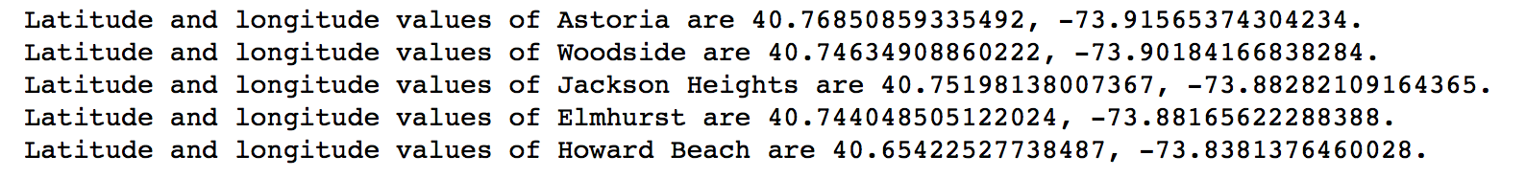
Exploratory data analysis – Queens(NYC)
Name and geo-location of Queens neighborhoods

Slide 8
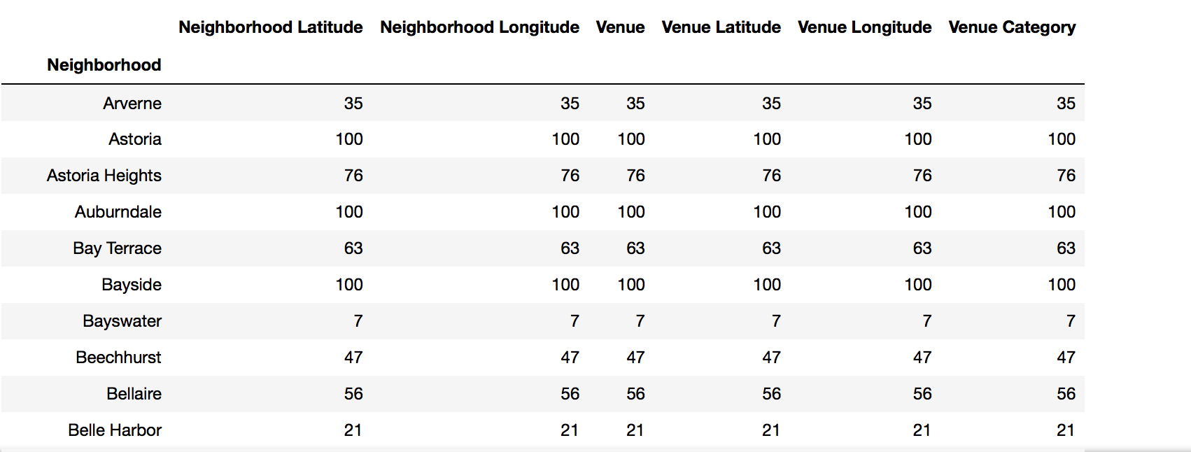
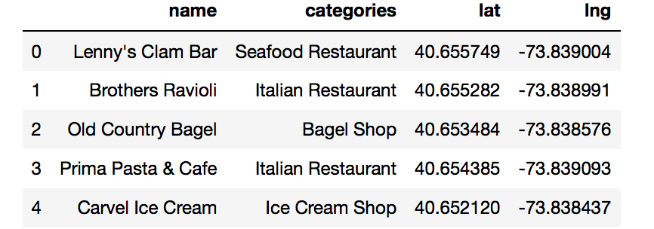
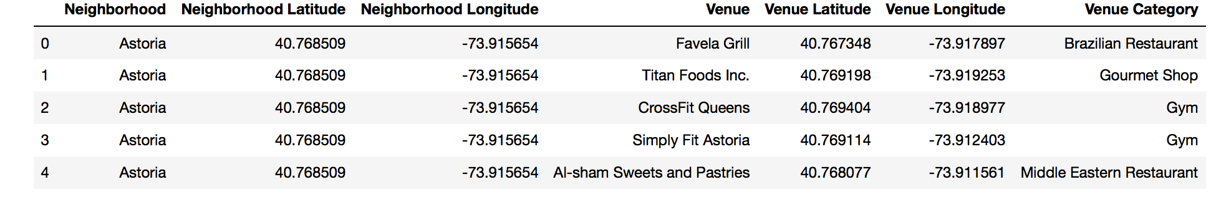
Exploratory data analysis – Queens(NYC)
Venue information of Queens

Slide 9
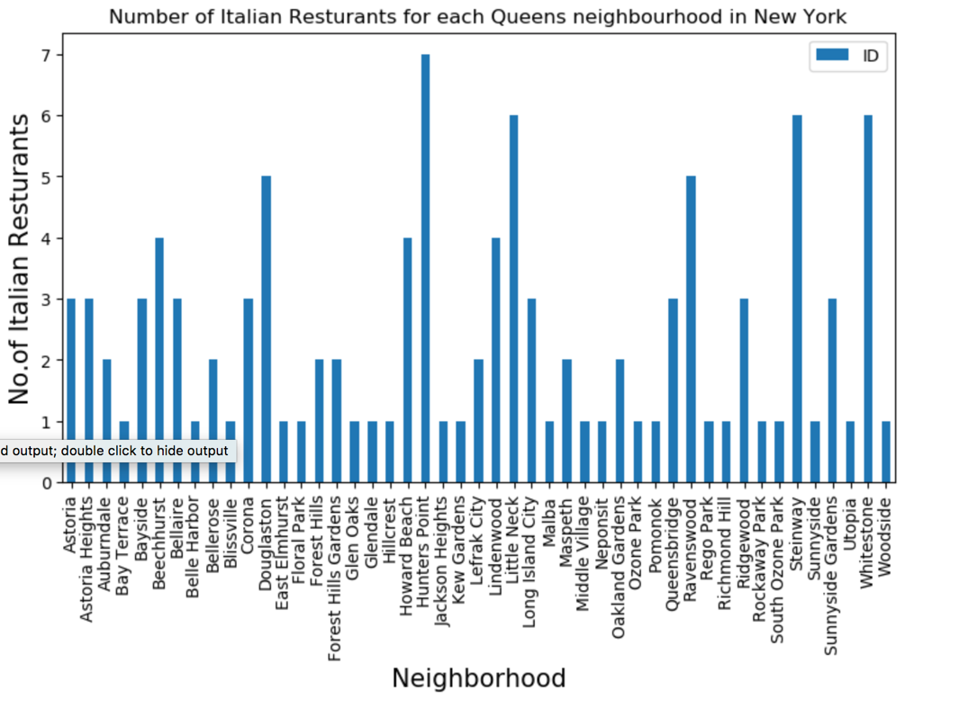
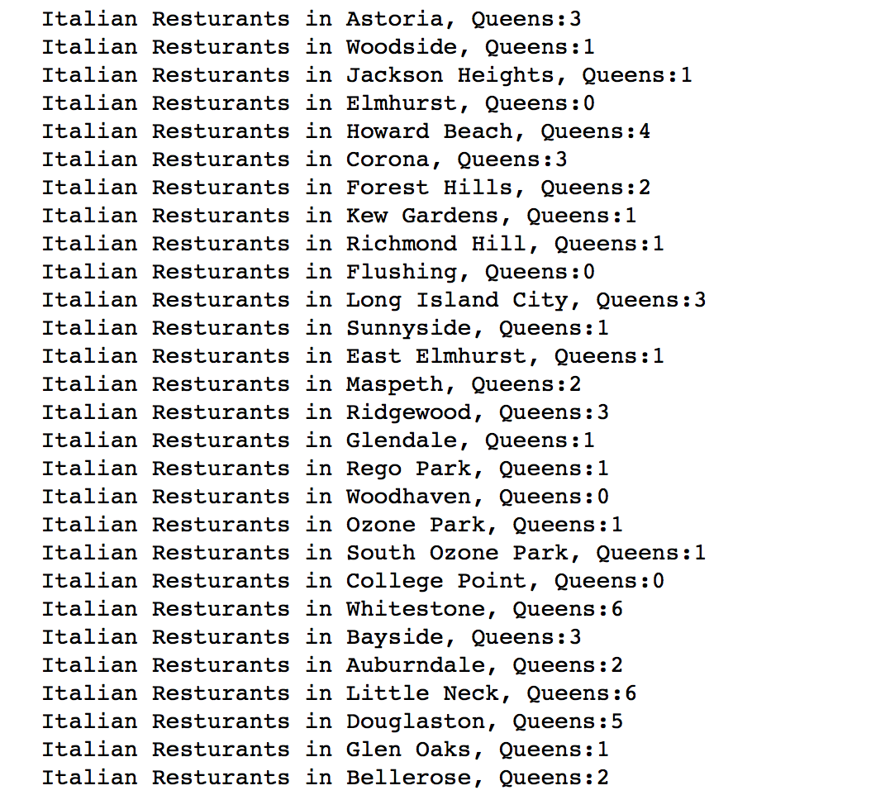
Exploratory data analysis – Queens Neighborhoods
Italian restaurant in Queens neighborhoods

Slide 10
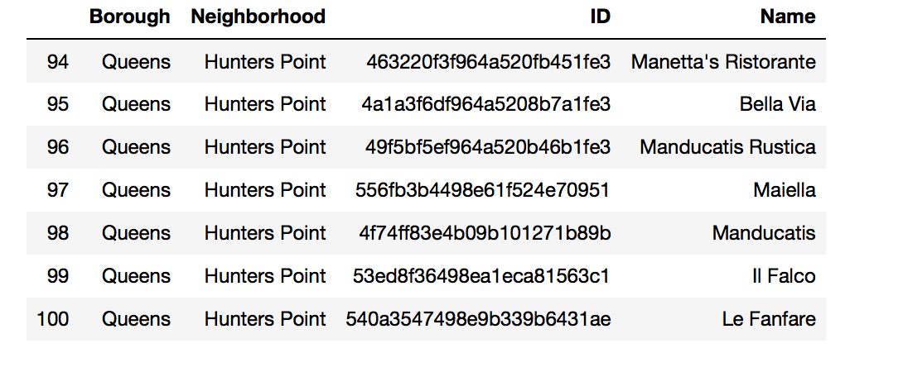
Exploratory data analysis – Queens(Hunters Point)
Italian restaurant in Queens neighborhoods – Hunters Point

Slide 11
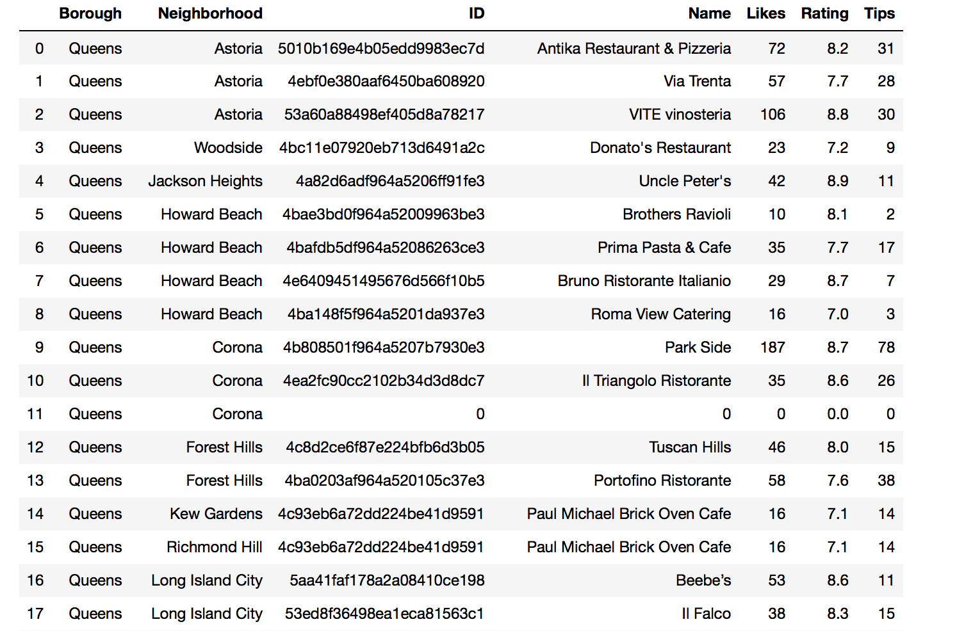
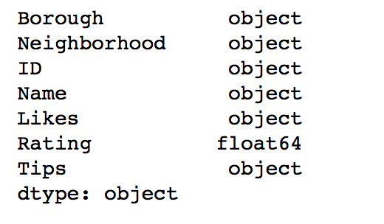
Exploratory data analysis – Italian Restaurant
Italian restaurant in Queens neighborhoods

Slide 12
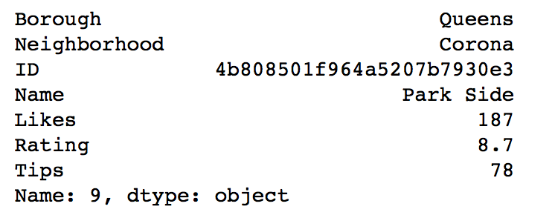
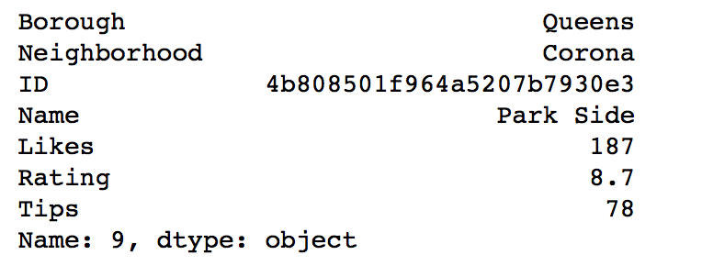
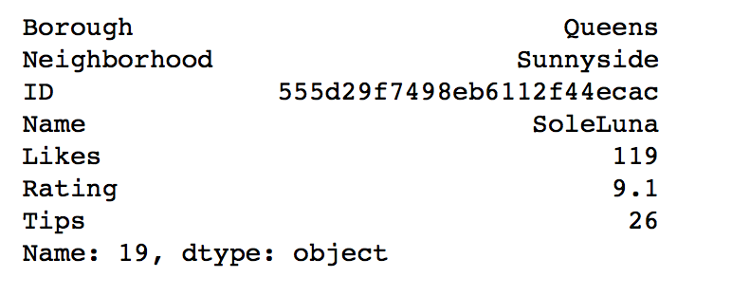
Exploratory data analysis – Italian Restaurant
Most LIKES Italian restaurant
Highest RATING Italian restaurant
Most TIPS Italian restaurant

Slide 13
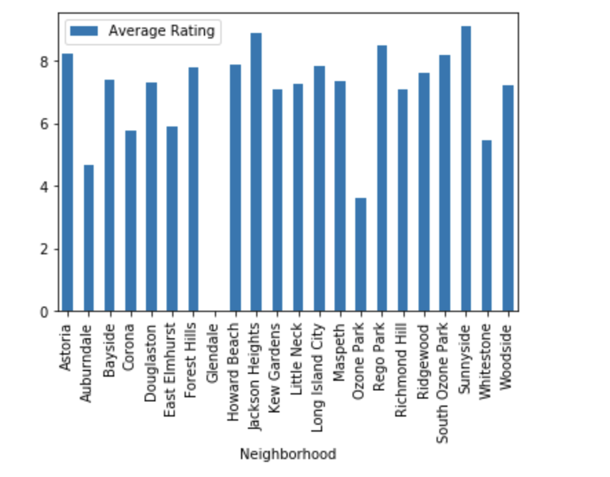
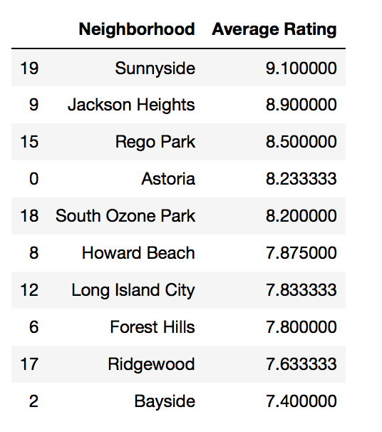
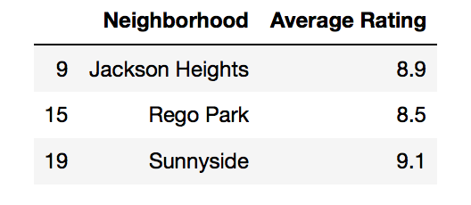
Exploratory data analysis – Italian Restaurant
Average rating of Italian restaurant in Queens

Slide 14
Conclusion
Queens has the most neighbourhoods among all 5 borough in New York City.
Hunters Point has the most Italian restaurant in Queens.
Park Side - Corona is the one which has the most LIKES by customers in Queens.
SoleLuna - Sunnyside has the highest RATING by customers in Queens.
Park Side - Corona has the most TIPS by customers in Queens.
Overall in Queens, Sunnyside has the highest average rating regards of Italian restaurants.

